Slide 1

Recursion Tree Method To Solve Recurrence Relation
Team Name: DU_CodeX_Legends
Md. Ashraful Alam (FH - 02)
Md. Tauseef - Ur - Rahman (FH - 24)
Sumaiya Tabassum (SK - 29)
Tamzid Bin Tariq (FH - 48)

Slide 2

Introduction

Slide 3
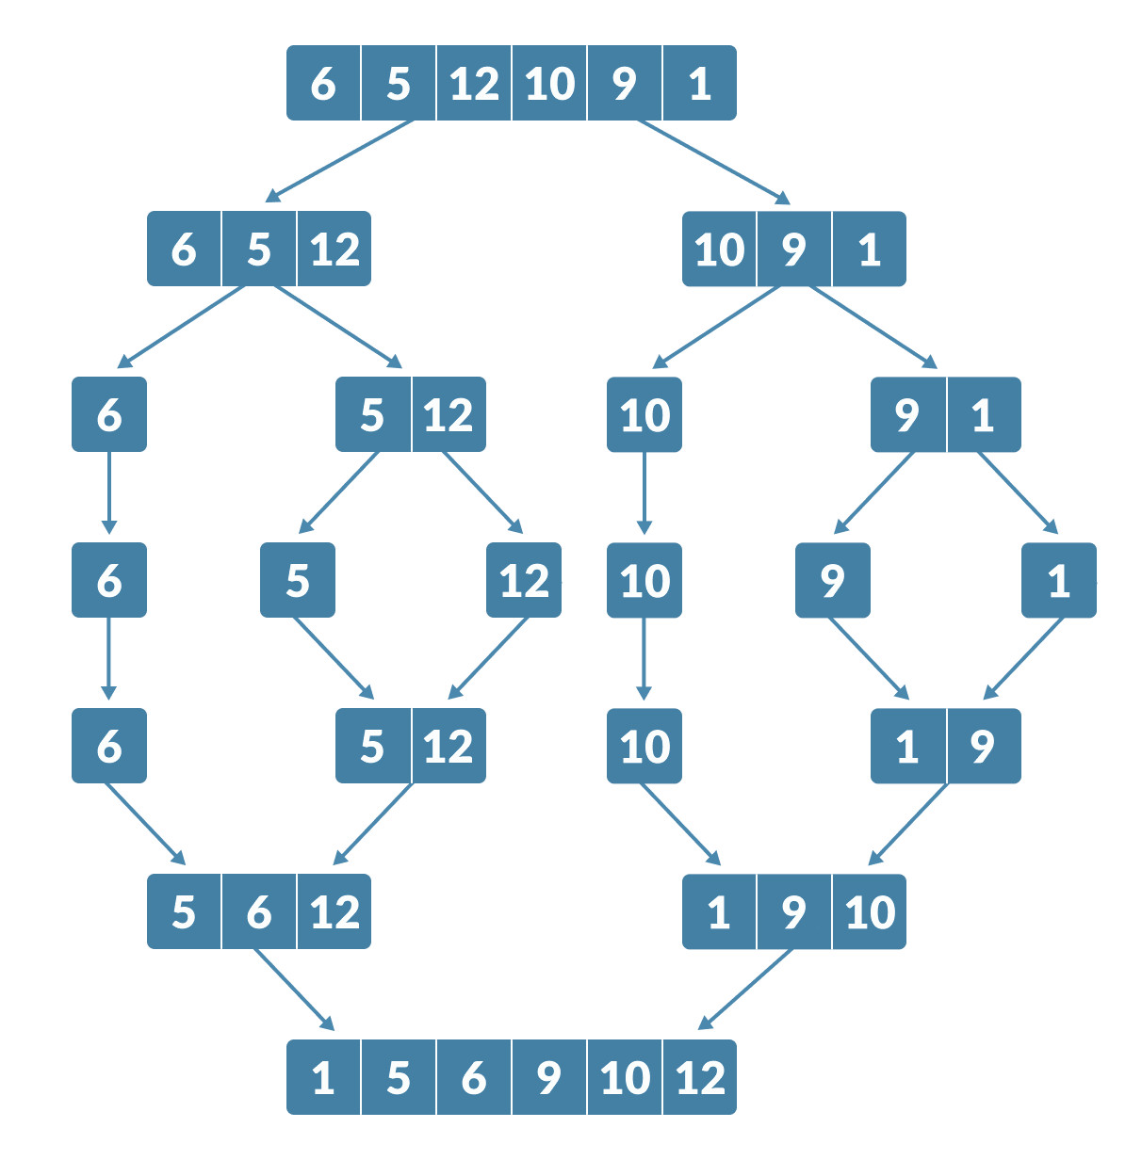
What is Recurrence Relation ?
Recurrence means something that occurs again and again.
A recurrence relation is an equation that defines a sequence based on a rule that gives the next term as a function of the previous term(s).
Example: In Merge Sort, we have to break the array into two halves again and again and sorting them, so the recurrence relation for that is:
T(n) = 2 x T(n/2) + n
Fig. Merge Sort

Slide 4
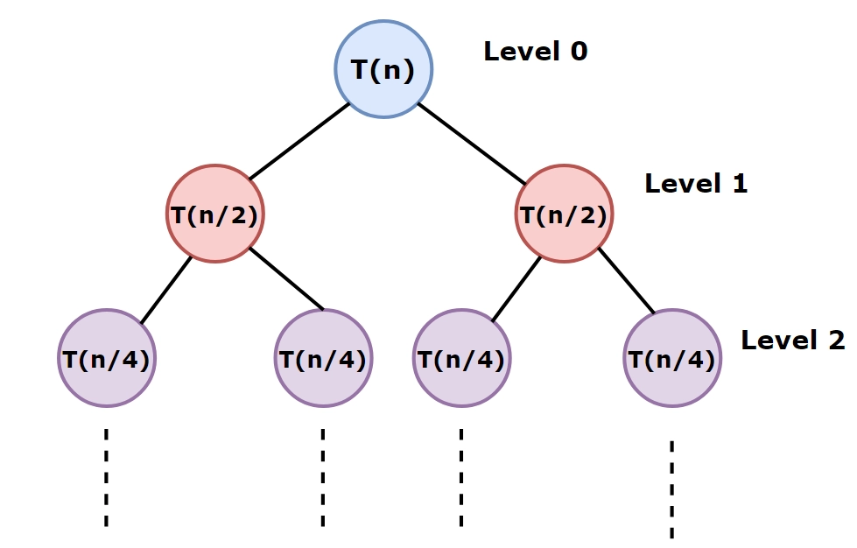
What is Recursion Tree Method ?
A recursion tree is a graphical representation that illustrates the execution flow of a recursive function.
A recursion tree consists of a root, and child nodes is a pictorial representation of a recurrence relation. Each node represents the cost of computing for a single subproblem of the original problem.
Example: Merge Sort can be visualized in a recursion tree, where each node represents a sub-array being examined.
FIg. Merge Sort represented in Recursion Tree Method

Slide 5

Problem Statement

Slide 6

Why Recursion Tree Method Is Used?
A recursion tree helps to visualize the recursive function.
Recursion tree is mainly used to generate a close guess to the actual complexity.
One can use recursion trees to develop an intuition of the underlying pattern, but they are not actual proofs.

Slide 7
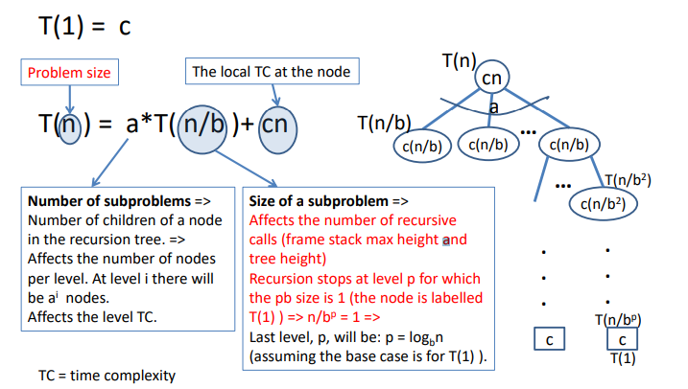
Key Terms

Slide 8
Examples of real-world applications
Algorithm/Problem | Recurrence Relation | Application | Time Complexity
Merge Sort | T(n)=2T(2n​)+O(n) | Efficient sorting for large datasets | O(nlogn)
Binary Search | T(n)=T(2n​)+O(1) | Fast search in sorted databases | O(logn)
Fast Fourier Transform (FFT) | T(n)=2T(2n​)+O(n) | Signal and image processing | O(nlogn)
Dynamic Programming | Varies depending on the problem | Example: Matrix Chain Multiplication | Problem-dependent
Pathfinding Algorithms | Divide-and-Conquer approach | Navigation systems and route optimization | Problem-dependent

Slide 9
Input and Output

Slide 10
What does the algorithm take as input?
A recurrence relation in the form:
T(n) = a * T(n/b) + f(n)
Where:
n: The size of the problem
a: Number of recursive calls
b: Division factor for problem size
f(n): Cost of non-recursive work per level

Slide 11
What does the algorithm produce as output?
The following factors should be taken into account while determining the output:
Time Complexity: An expression quantifying the overall runtime, typically in Big-O notation.
Space Complexity: Measures the amount of auxiliary memory used during the recursion.

Slide 12
Example of what the algorithm produces as output
Recurrence Relation:
T(n) = 2 * T(n/2) + n (for Merge Sort)
Input Values:
Problem size n = 8
Recursive calls a = 2
Division factor b = 2
Work per level f(n) = n

Slide 13
Example of what the algorithm produces as output
Step-by-Step Recursion Tree:
Level 0: n = 8, Work = 8
Level 1: n = 4, Work = 4 + 4
Level 2: n = 2, Work = 2 + 2 + 2 + 2
Level 3: Base case with n = 1
Final Complexity:
Time Complexity: O(n * log⁡n)
Space Complexity: O(log⁡n)
This is due to the depth of the recursion tree (for example: the number of recursive levels).

Slide 14
Key Intuition

Slide 15
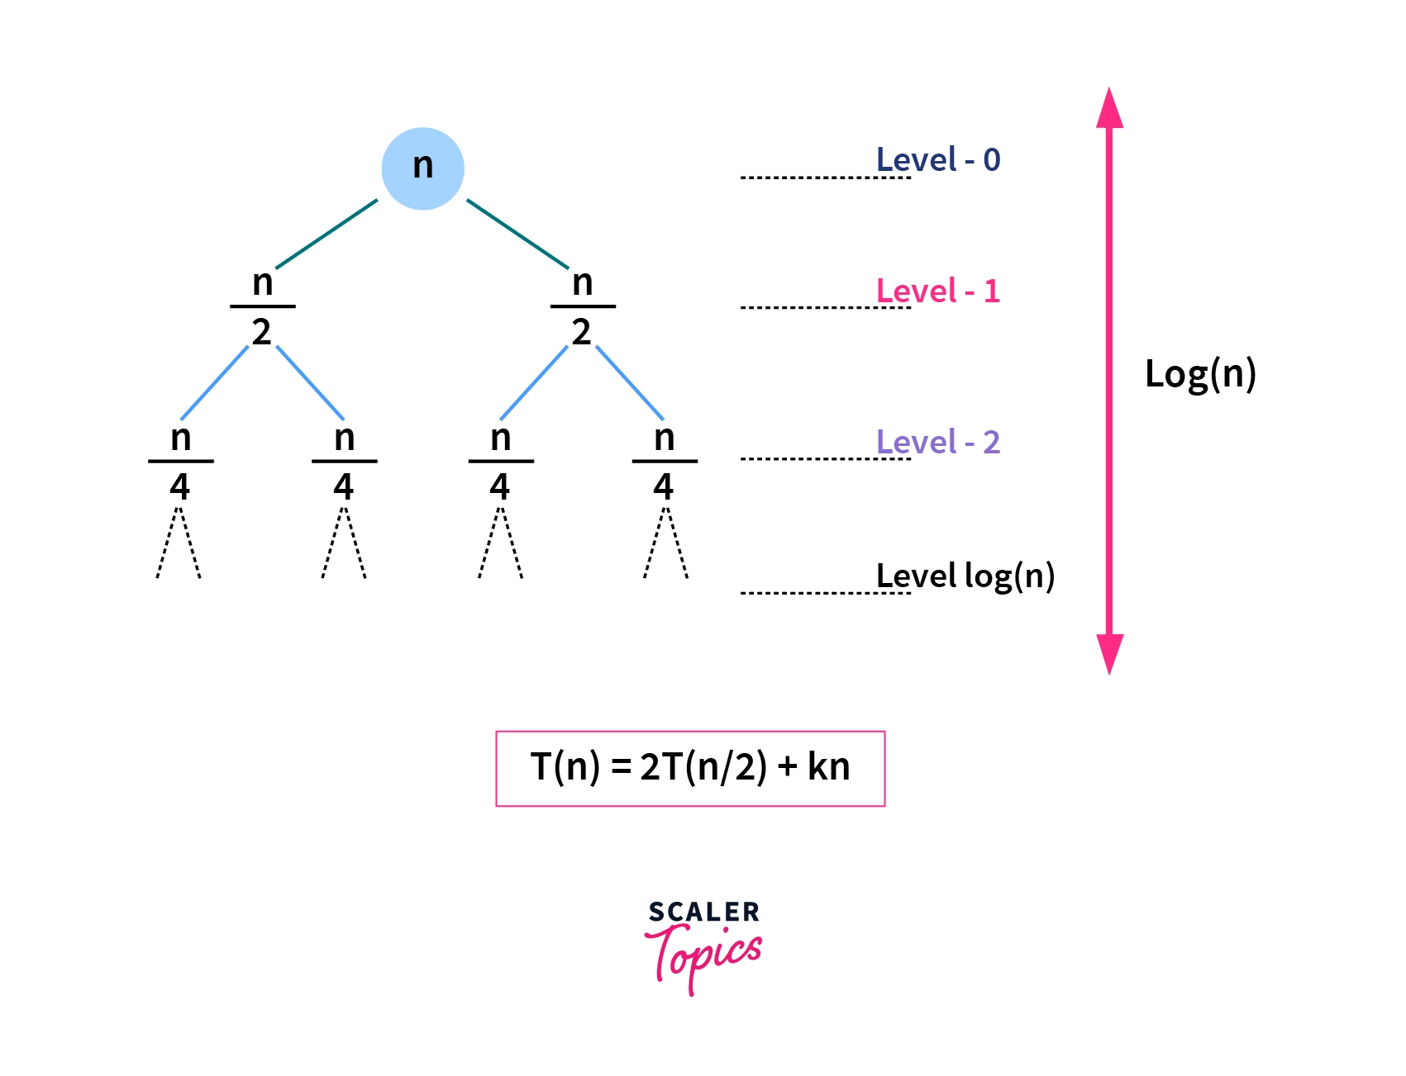
Key Intuitions:
The value of the node at each level is nothing but the size of the problem at that level.
The height of the recursion tree is equal to the number of levels in the tree.
At the last level, the sub-problem size will be reduced to 1, and that is the base case.
To solve the recurrence, you sum the costs of all the nodes in the tree.
1 1 1 1 1 1 1 1

Slide 16
Algorithm Steps

Slide 17
Algorithm Steps
Step 3
Step 2
Step 1
Complexity Derivation: Calculating time complexity of the given recurrence relation
Analyzing the Drawn Recursion Tree
Draw the Recursion Tree

Slide 18
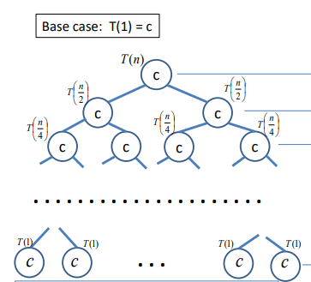
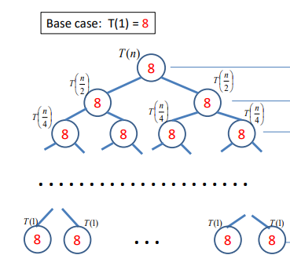
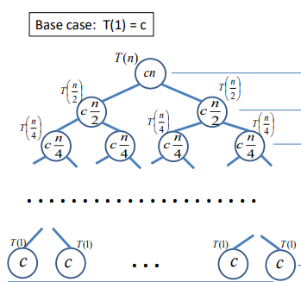
Algorithm Steps
Step - 1: Draw the Recursion Tree
T(n) = 2T(n/2) + c
T(n) = 2T(n/2) + 8
T(n) = 2T(n/2) + cn

Slide 19
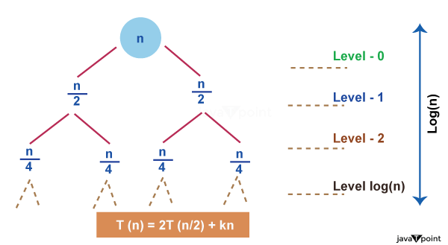
Algorithm Steps
Step - 2: Analyzing The Drawn Recursion Tree
We determine this metrics from the drawn Recursion tree from first step:
Finding the total number of levels (height ) in the recursion tree.
Computing the cost of each level in the tree. It must be same for each level.
Calculating the total number of nodes in the last level of the tree.
Compute the cost of the last level.

Slide 20
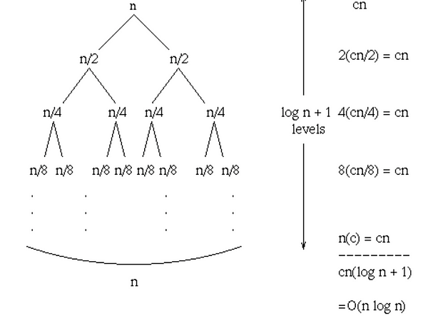
Algorithm Steps
Step - 3: Complexity Analysis
The total cost can be written as,
Total Cost = Cost of all levels except last level + Cost of last level
Total Cost = Cost for level-0 + Cost for level-1 + Cost for level-2 +.... + Cost for level-log(n) + Cost for last level
The cost of the last level is calculated separately because it is the base case and no merging is done at the last level so, the cost to solve a single problem at this level is some constant value. Let's take it as O (1).
Fig. Finding Time Complexity of T(n)=2T(n/2)+c

Slide 21
Example Walkthrough

Slide 22
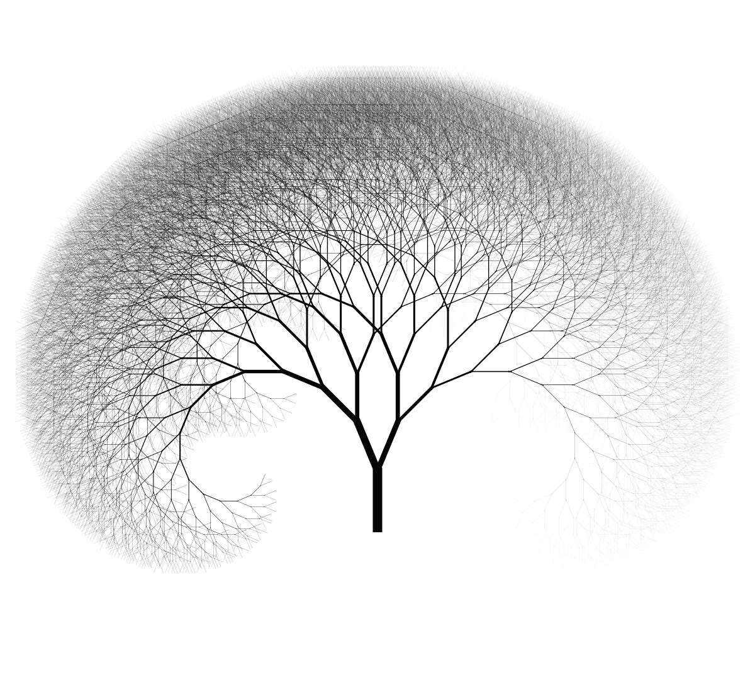
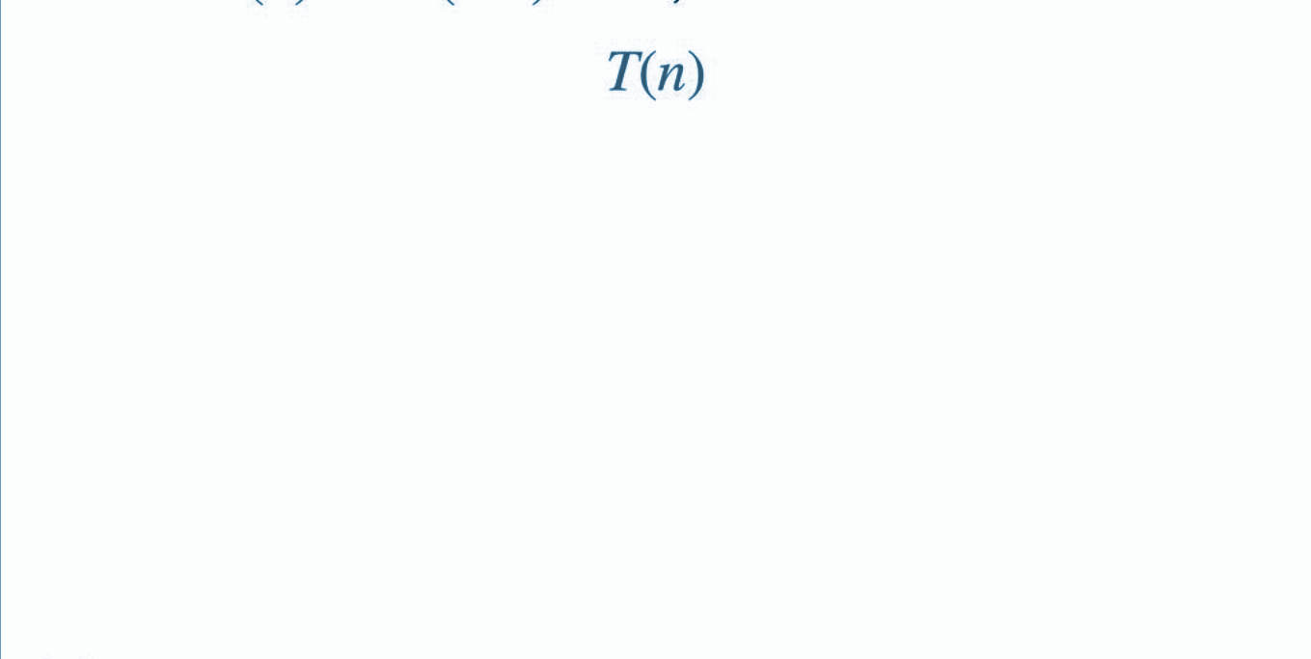
Example Walkthrough
Example: T(n) = 2T (n/2) + dn, where d>0 is constant
Step1: Drawing the Recursion Tree:

Slide 23
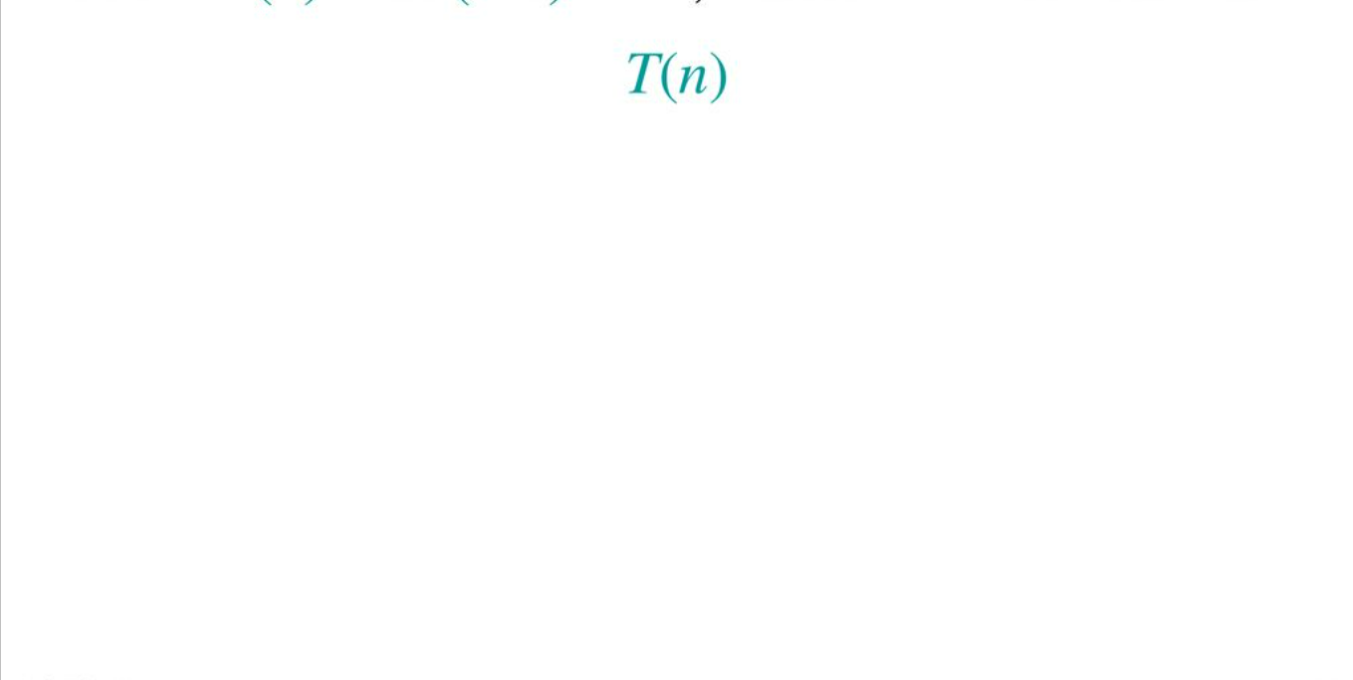
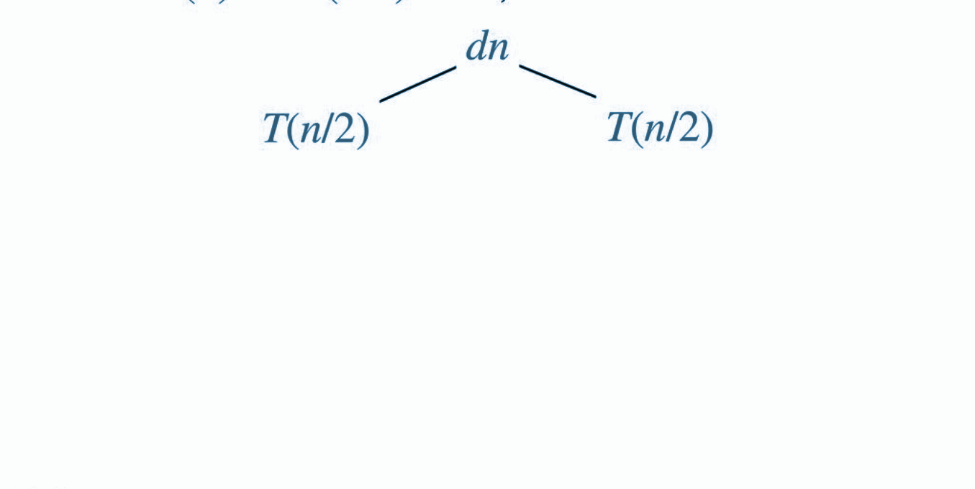
Example Walkthrough
Example: T(n) = 2T (n/2) + dn, where d>0 is constant
Step1: Drawing the Recursion Tree:

Slide 24
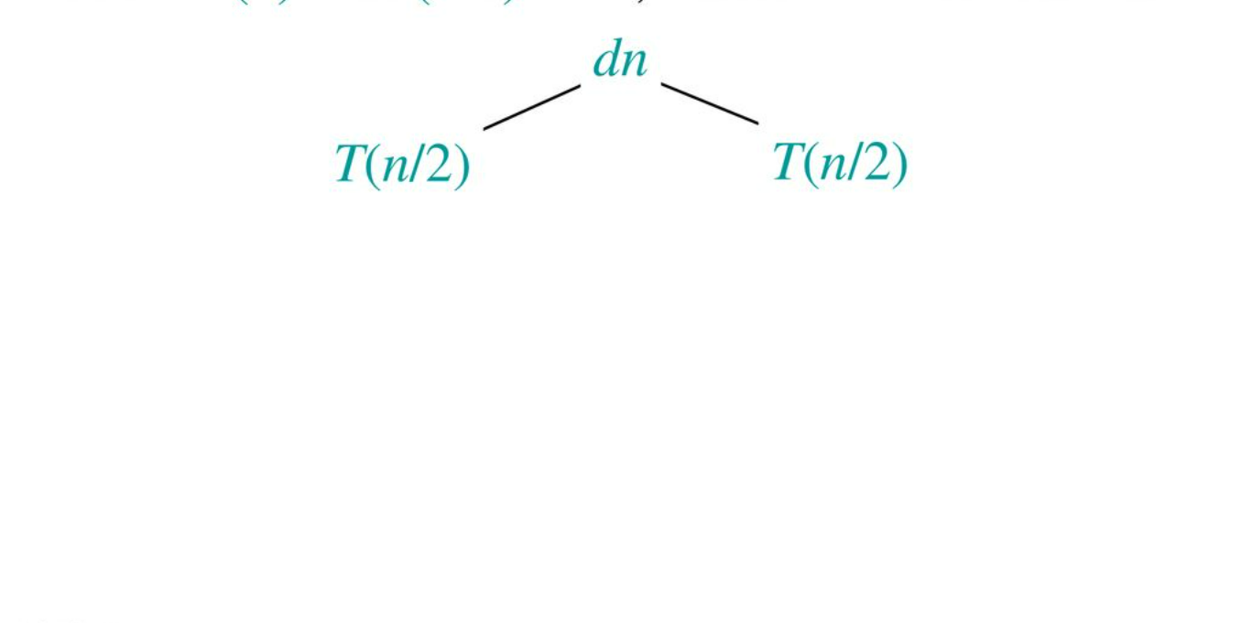
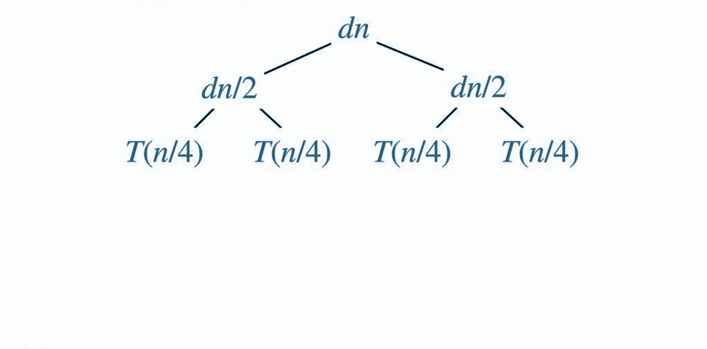
Example Walkthrough
Example: T(n) = 2T (n/2) + dn, where d>0 is constant
Step1: Drawing the Recursion Tree:

Slide 25
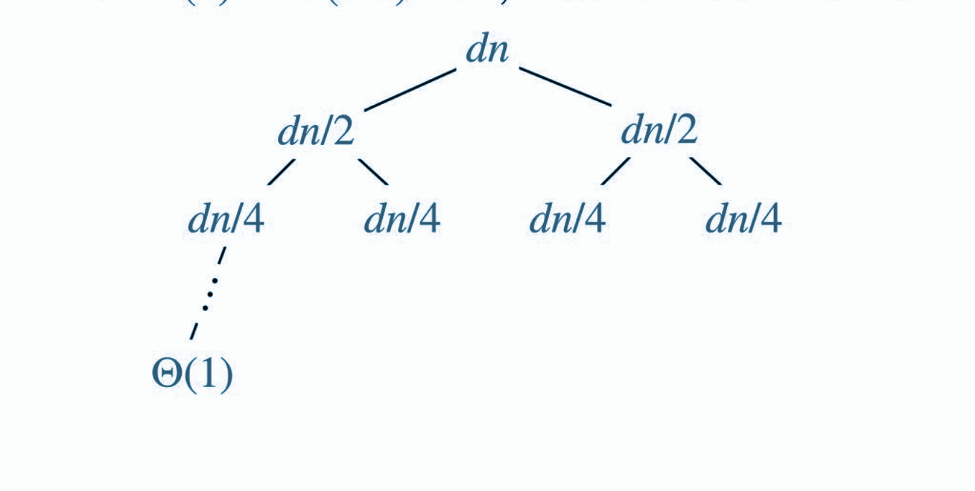
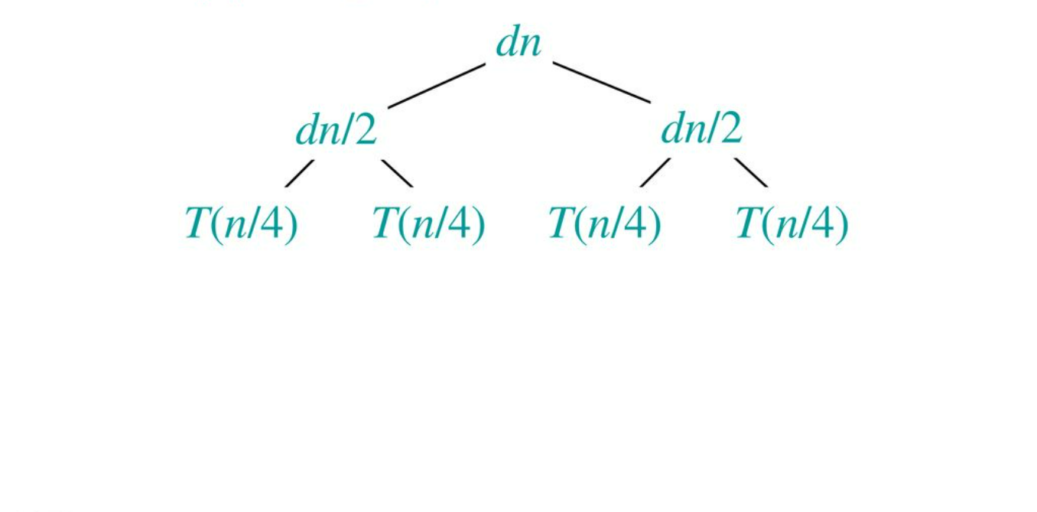
Example Walkthrough
Example: T(n) = 2T (n/2) + dn, where d>0 is constant
Step1: Drawing the Recursion Tree:

Slide 26
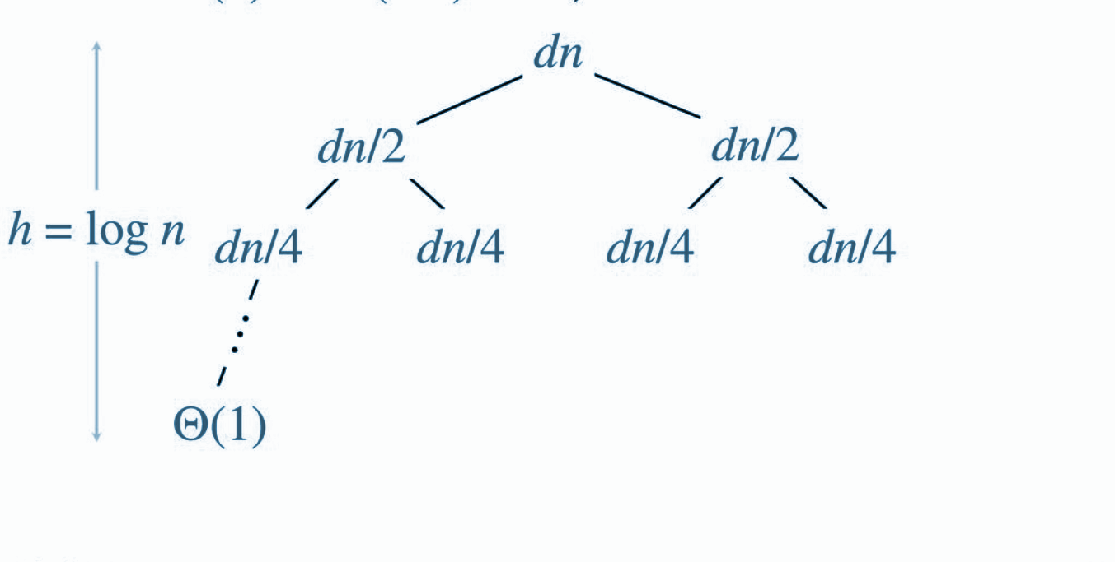
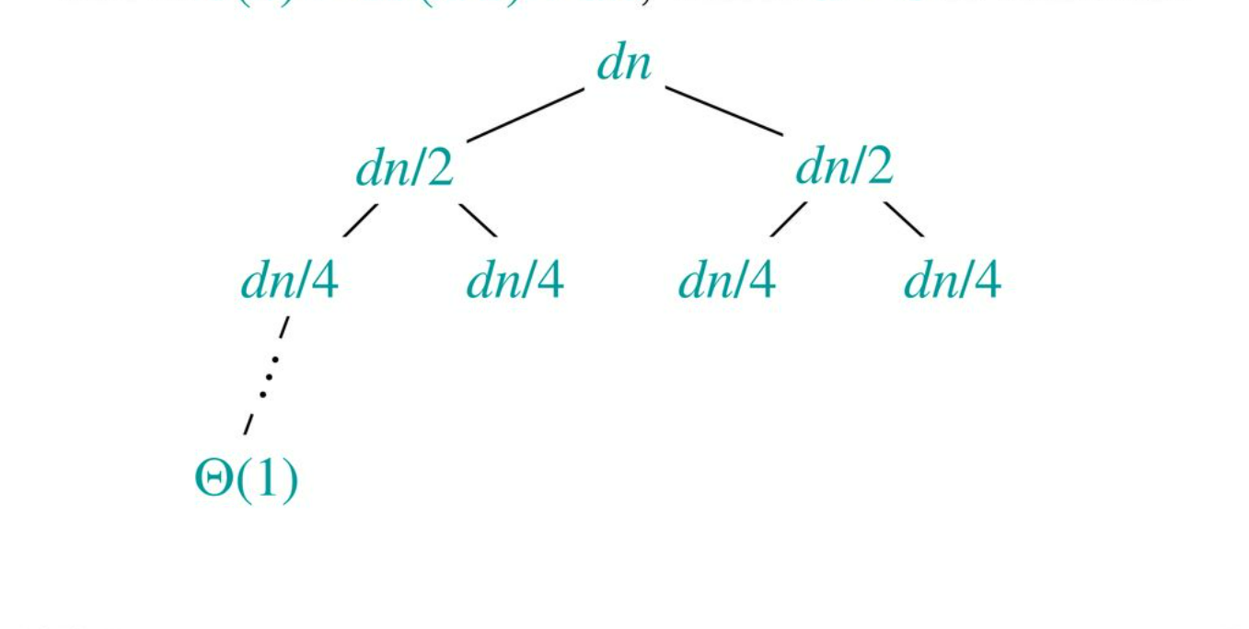
Example Walkthrough
Example: T(n) = 2T (n/2) + dn, where d>0 is constant
Step2: Analyzing the Drawn Recursion Tree:

Slide 27
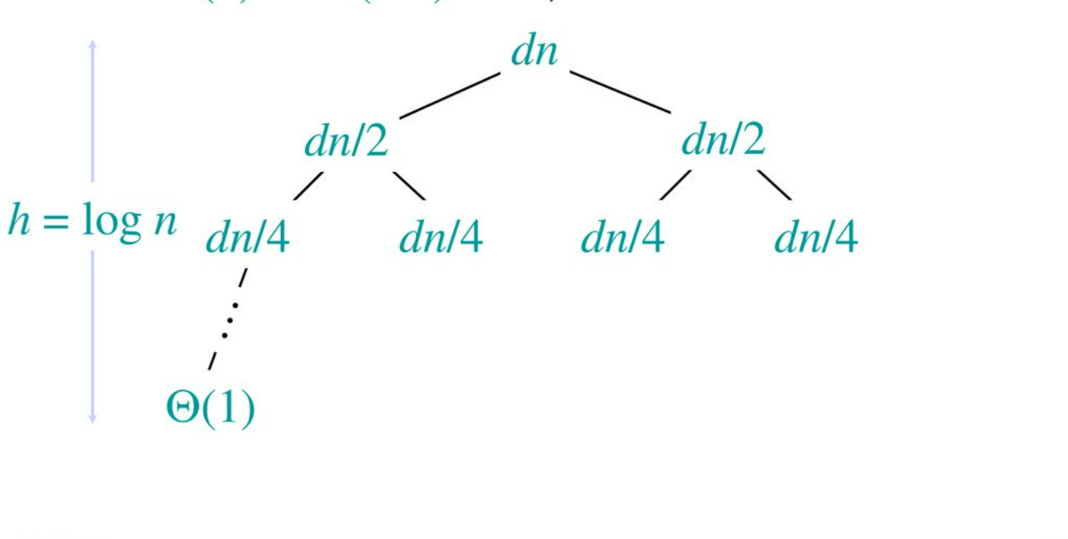
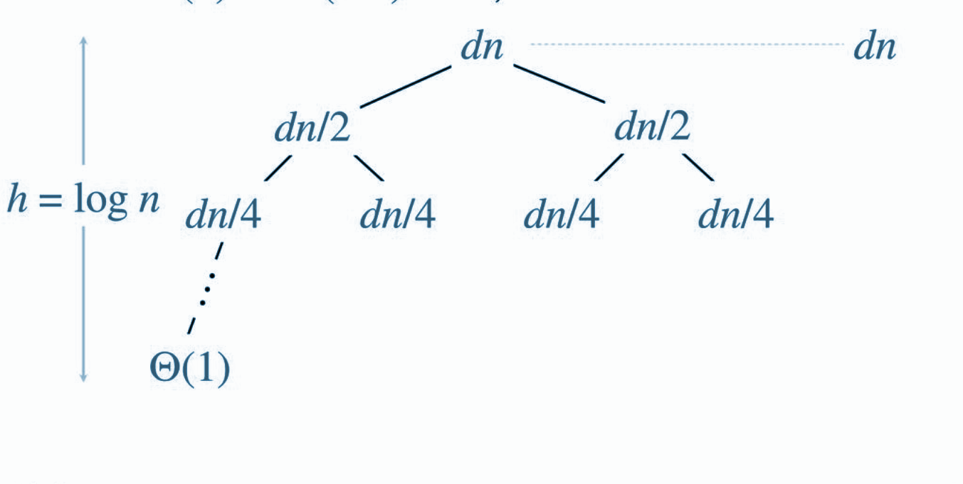
Example Walkthrough
Example: T(n) = 2T (n/2) + dn, where d>0 is constant
Step2: Analyzing the Drawn Recursion Tree:

Slide 28
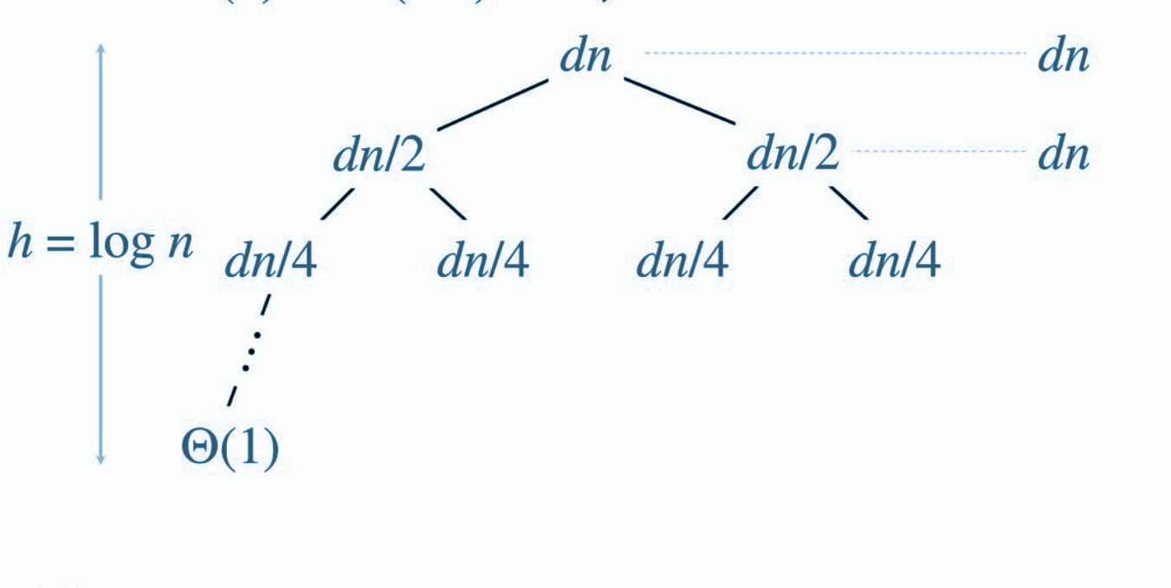
Example Walkthrough
Example: T(n) = 2T (n/2) + dn, where d>0 is constant
Step2: Analyzing the Drawn Recursion Tree:

Slide 29
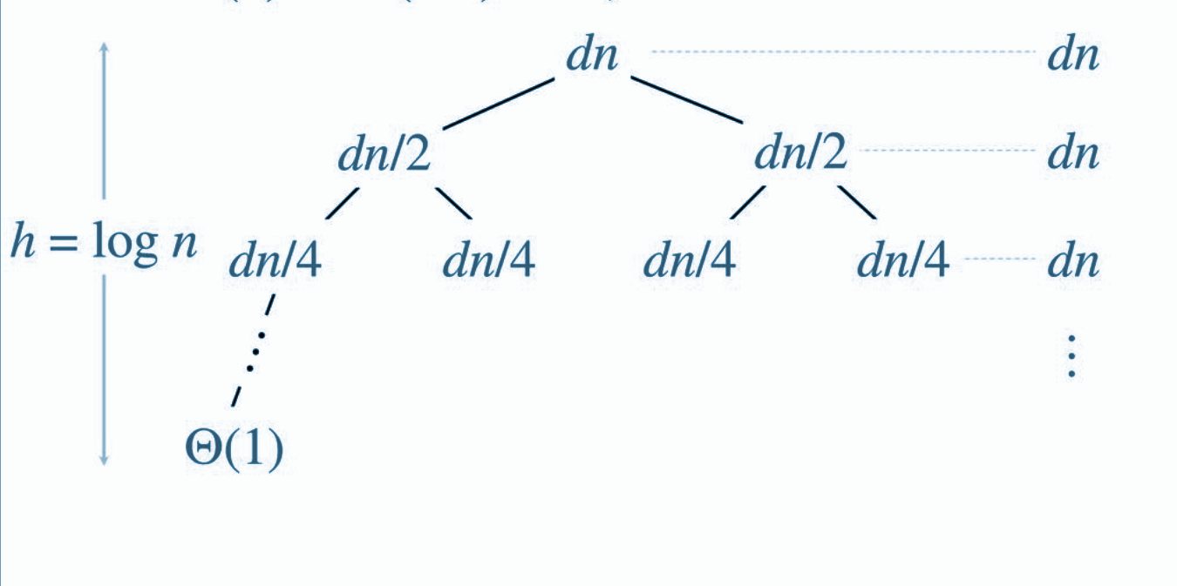
Example Walkthrough
Example: T(n) = 2T (n/2) + dn, where d>0 is constant
Step2: Analyzing the Drawn Recursion Tree:

Slide 30
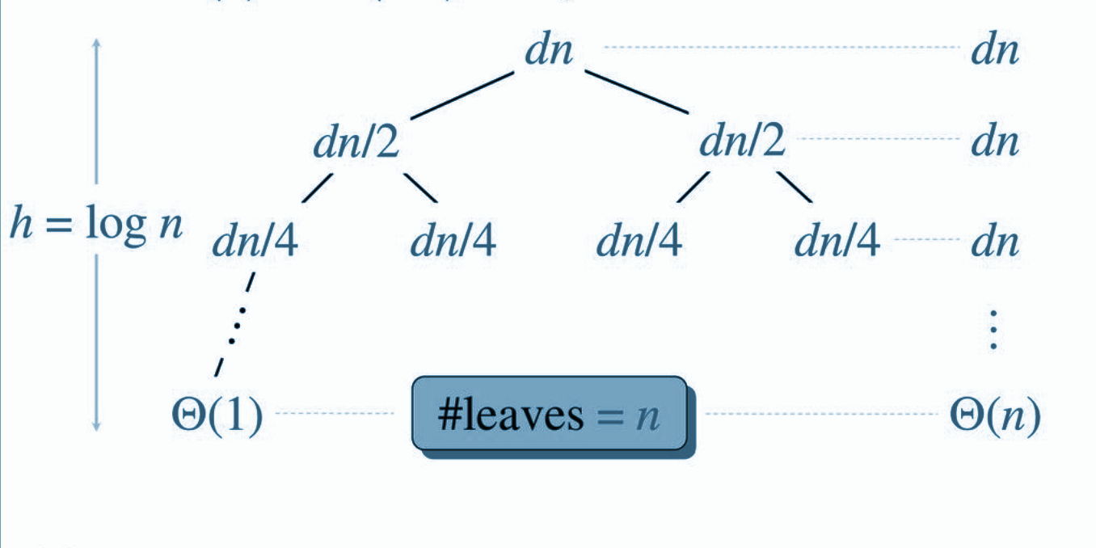
Example Walkthrough
Example: T(n) = 2T (n/2) + dn, where d>0 is constant
Step2: Analyzing the Drawn Recursion Tree:

Slide 31
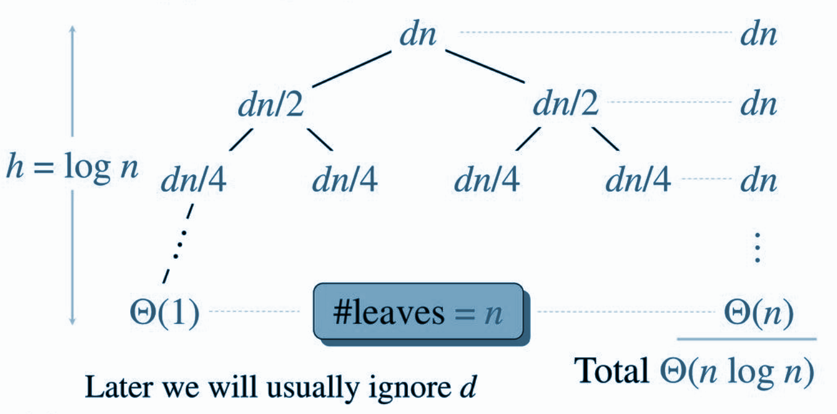
Example Walkthrough
Example: T(n) = 2T (n/2) + dn, where d>0 is constant
Step 3: Complexity Analysis

Slide 32
Strengths & Limitations

Slide 33
Strengths vs Limitations
Visual Representation
Useful for DIvide and Conquer Algorithm
Easy to Derive Complexity
Layer-wise Analysis
Supports Asymptotic Analysis
Tedious for Complex Relations
Requires Pattern Recognition
Not Always Exact
Has Limitation for Non-Divide-and-Conquer Relations
Involves Manual Calculations
Dependent on Base Case

Slide 34
Applications

Slide 35
Applications - Practical Use Cases in Different Fields
Computer Science: Analyzing and Optimizing algorithms for sorting, searching, and data compression.
Data Analytics: Efficient computation for large datasets.
Networking: Signal processing and efficient encoding algorithms.
Artificial Intelligence: Recursive approaches in decision trees and neural networks.

Slide 36
Applications - Examples of Real-World Systems
Merge Sort:
Used by databases and search engines for efficient data sorting.
Example: Google Search indexing large datasets.
Binary Search:
Applied in search functionalities of online platforms.
Example: Amazon product searches and binary search trees in databases.
Fast Fourier Transform (FFT):
Essential in multimedia applications for audio and video compression.
Example: MP3 audio compression and JPEG image processing.

Slide 37
Applications - Examples of Real-World Systems
Dynamic Programming:
Used for optimization problems in financial modeling and software development.
Example: Flight price optimization in airline booking systems.
Pathfinding Algorithms:
Utilized in GPS systems and gaming environments for route optimization.
Example: Google Maps for finding the fastest route.
Optimization Problems:
Recursive tree helps to visualize and analyze the optimization problems like Backtrack/Knapsack.

Slide 38

References

Slide 39
References
https://takeuforward.org/recursion/recursion-tree-method-for-solving-recurrence
https://www.naukri.com/code360/library/recursion-tree-method
https://www.javatpoint.com/daa-recursion-tree-method
https://www.scaler.in/recursion-tree-method/
https://www.geeksforgeeks.org/recurrence-relations-a-complete-guide/

Slide 40

INDIVIDUAL RESPONSIBILITY

Slide 41

Contribution by each team member
Contribution by each team member
Md. Tauseef - Ur - Rahman (FH - 24)
Md. Ashraful Alam (FH - 02)
Helped creating and modifying the slides
Added -
Diagram
Images
Animations
Analyzed the algorithm basics and added formulas and explained complexities
Slides made and modified: Title Slide, Introduction, Problem Statement, Example Walkthrough

Slide 42

Contribution by each team member
Contribution by each team member
Md. Tauseef - Ur - Rahman (FH - 24)
Md. Tauseef - Ur - Rahman (FH - 24)
Added and modified slide contents
Added -
Tables
Formulas
Analyzing the algorithm's input and output, as well as explaining the formula and complexities
Slides made and modified: Problem Statement, Inputs and Outputs, Applications, Complexity Analysis

Slide 43

Contribution by each team member
Contribution by each team member
Md. Tauseef - Ur - Rahman (FH - 24)
Sumaiya Tabassum (SK - 29)
Modified all slides to make them visually appealing and added contents to the slides
Modified -
Diagrams
Recursion trees and
Graphical representations of algorithms.
Added animations
Slides made and modified: Input and Output, Problem Statement, Key Intuition, Algorithm Steps, Example Walkthrough, Complexity Analysis, Strengths and Limitations, Applications, References

Slide 44

Contribution by each team member
Tamzid Bin Tariq (FH - 48)
Created visually appealing slides
Added -
Diagrams
Recursion trees and
Graphical representations of algorithms.
Implemented practical examples of recursion trees and analyzed their complexities, explaining the behavior of the algorithm.
Slides made and modified: Key Intuition, Algorithm Steps, Example Walkthrough, Complexity Analysis, Strengths and Limitations, Applications, References

Slide 45
Thank You

